Slide 1
Chapter 2 Basic Structures: Sets, Functions, Sequences, Sums, and Matrices
Section 2.3 : Functions

Slide 2

Functions
A function $f$from $A$ to $B$ is an assignment of exactly one element of $B$ to each element of $A$.
We write $f(a) = b$if $b$ is the unique element of $B$ assigned by the function f to the element a of $A.$
Iff is a function from $A to B$, we write $f : A → B.$

Slide 3
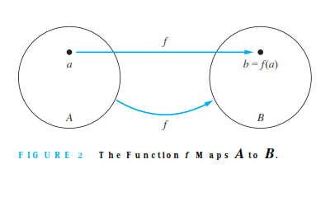
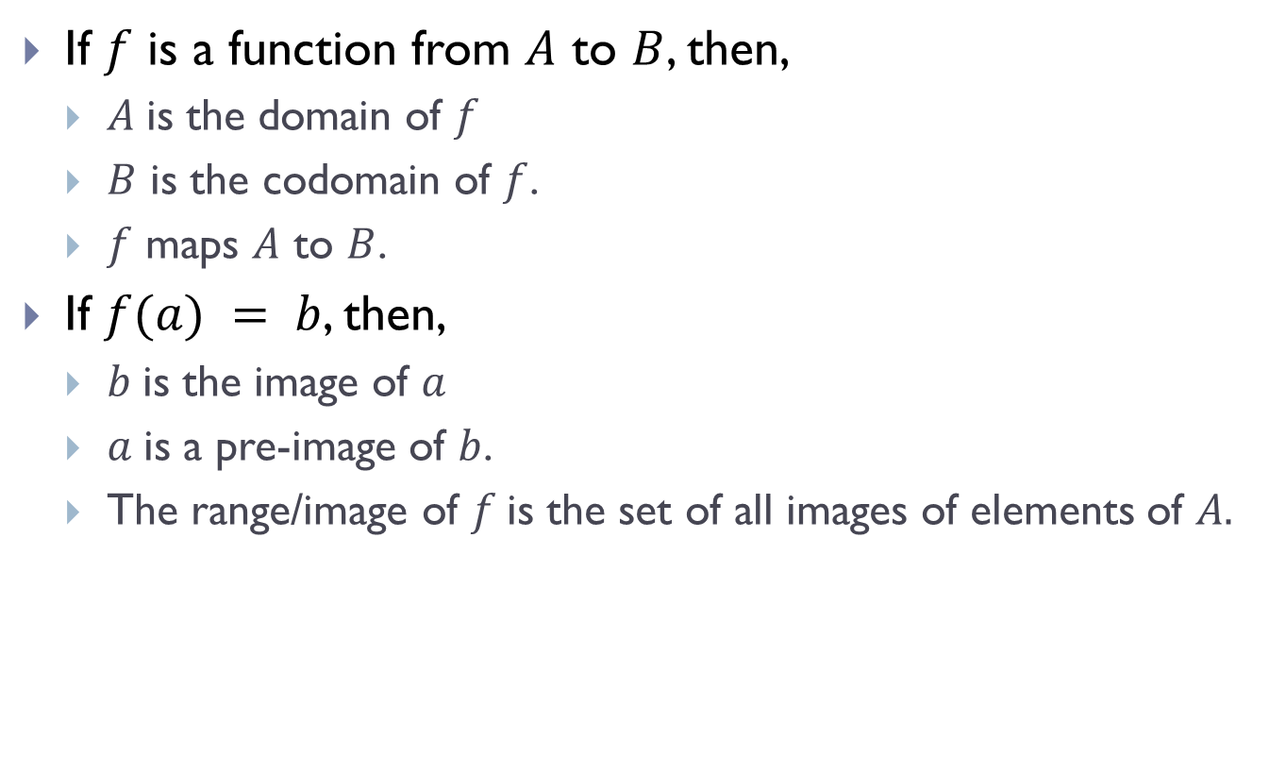
Functions (Contd.)
If $f$ is a function from $A$ to $B$, then,
$A$is the domain of $f$
$B$ is the codomain of $f$.
$f$ maps $A$ to $B$.
If $f(a) = b$, then,
$b$is the image of $a$
$a$is a pre-image of $b$.
The range/image of $f$is the set of all images of elements of $A.$

Slide 4
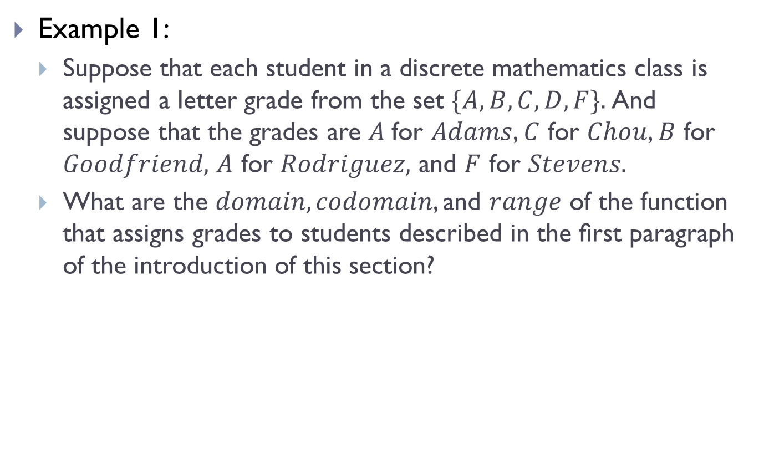
Functions (Contd.)
Example 1:
Suppose that each student in a discrete mathematics class is assigned a letter grade from the set $\{A, B, C, D, F\}.$And suppose that the grades are $A$for $Adams$, $C$ for $Chou$, $B$ for $Goodfriend,$ $A$ for $Rodriguez,$ and $F$ for $Stevens.$
What are the $domain, codomain$, and $range$ of the function that assigns grades to students described in the ﬁrst paragraph of the introduction of this section?

Slide 5
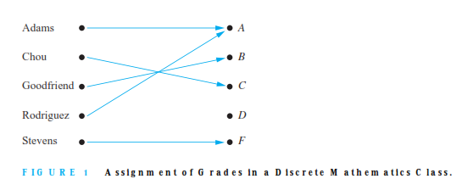
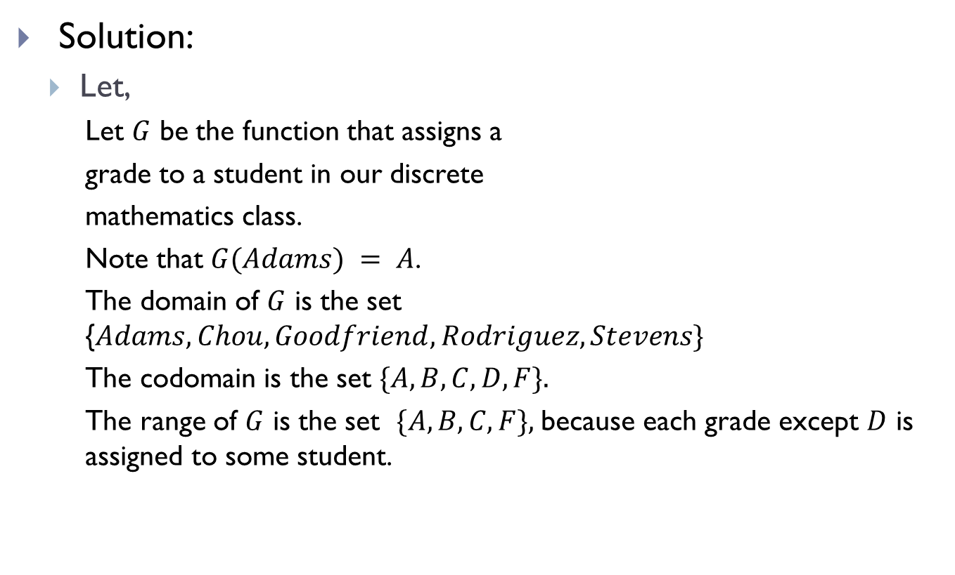
Functions (Contd.)
Solution:
Let,
Let $G$ be the function that assigns a
grade to a student in our discrete
mathematics class.
Note that $G(Adams) = A$.
The domain of $G$ is the set {$Adams, Chou, Goodfriend, Rodriguez, Stevens\}$
The codomain is the set $\{A, B, C, D, F\}.$
The range of $G$ is the set $\{A, B, C, F\},$because each grade except $D$ is assigned to some student.

Slide 6

Functions(Contd.)
Let $f1$ and $f2$ be functions from $A$ to $R$.
Then $f1+ f2$and $f1f2$ are also functions from $A$ to $R$ deﬁned for all $x ∈ A$by
$(f1+ f2)(x) = f1(x) + f2(x)$
$(f1f2)(x) = f1(x)f2(x).$

Slide 7
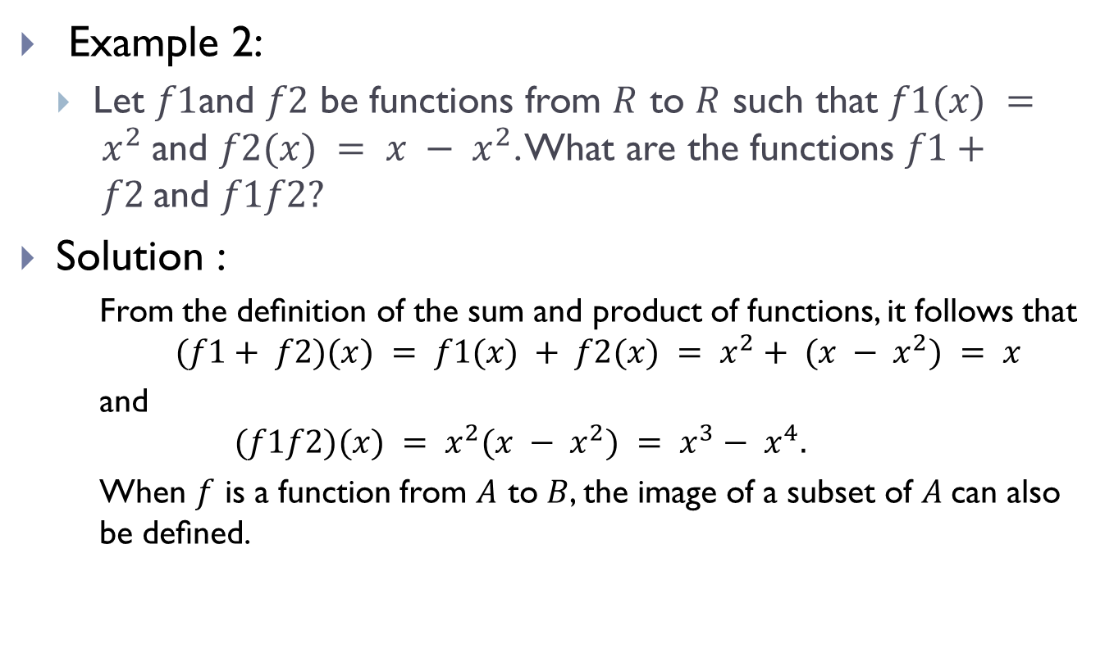
Functions(Contd.)
Example 2:
Let $f1$and $f2$ be functions from $R$ to $R$ such that $f1(x) = x^{2}$and $f2(x) = x − x^{2}$. What are the functions $f1+ f2$and $f1f2?$
Solution :
From the deﬁnition of the sum and product of functions, it follows that
$$(f1+ f2)(x) = f1(x) + f2(x) = x^{2}+ (x − x^{2}) = x$$
and
$$(f1f2)(x) = x^{2}(x − x^{2}) = x^{3}− x^{4}.$$
When $f$ is a function from $A$ to $B$, the image of a subset of $A$can also be deﬁned.

Slide 8
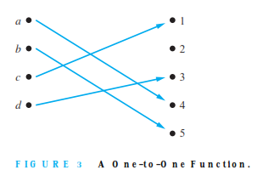
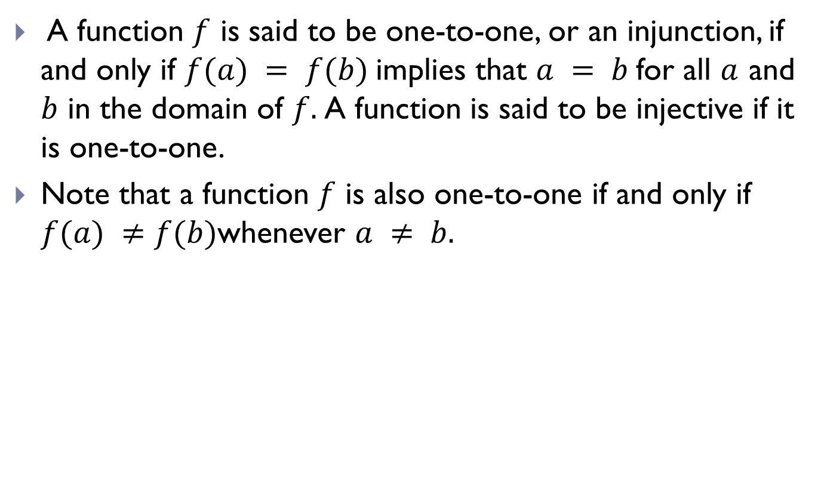
One-to-One Functions/Injunctions
A function $f$ is said to be one-to-one, or an injunction, if and only if $f(a) = f(b)$implies that $a = b$for all $a$ and $b$ in the domain of $f.$A function is said to be injective if it is one-to-one.
Note that a function $f$ is also one-to-one if and only if $f(a) ≠f(b)$whenever $a ≠ b.$

Slide 9
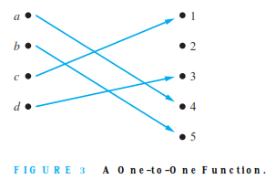
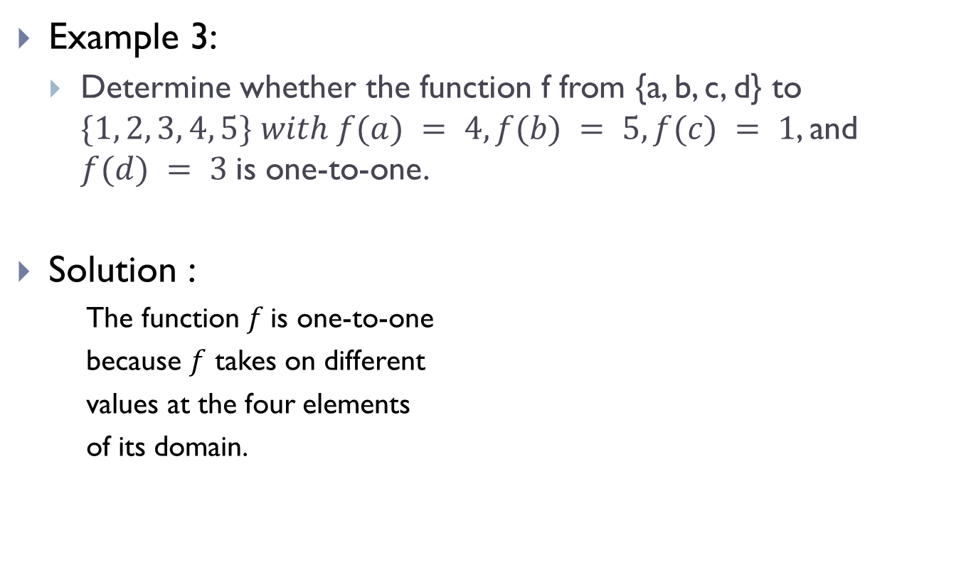
One-to-One Functions/Injunctions (Contd.)
Example 3:
Determine whether the function f from {a, b, c, d} to $\{1, 2, 3, 4, 5\} with f(a) = 4, f(b) = 5,f(c) = 1$, and $f(d) = 3$is one-to-one.
Solution :
The function $f$is one-to-one
because $f$ takes on different
values at the four elements
of its domain.

Slide 10
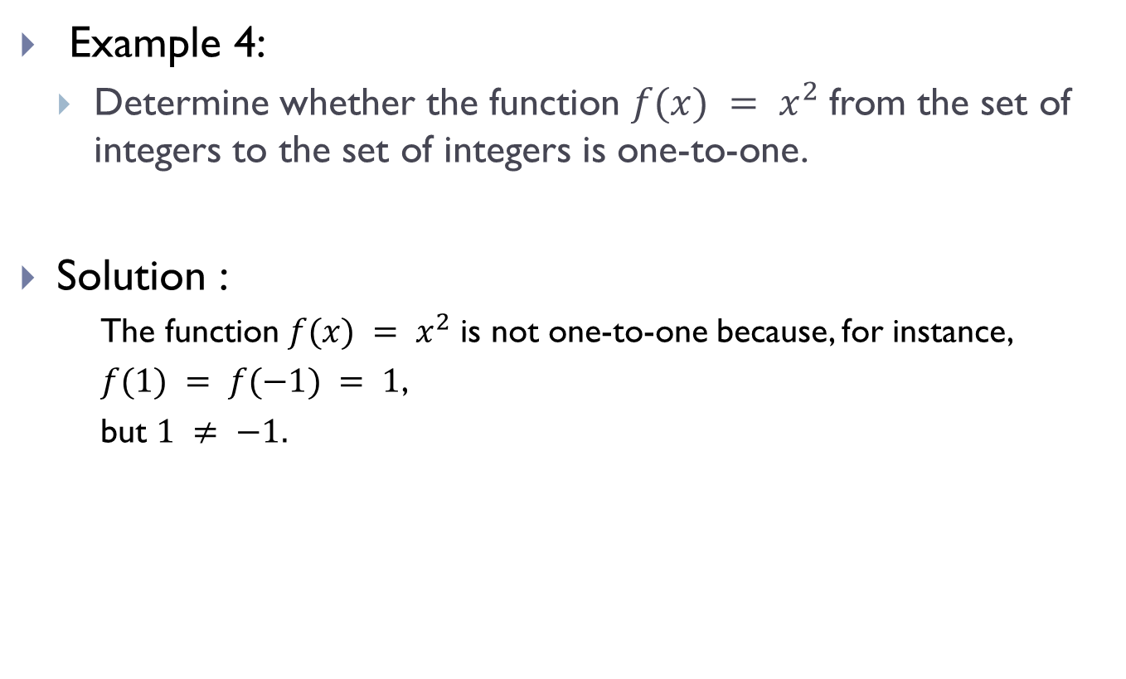
One-to-One Functions/Injunctions (Contd.)
Example 4:
Determine whether the function $f(x) = x^{2}$from the set of integers to the set of integers is one-to-one.
Solution :
The function $f(x) = x^{2}$is not one-to-one because, for instance,
$f(1) = f(−1) = 1$,
but $1 ≠ −1.$

Slide 11
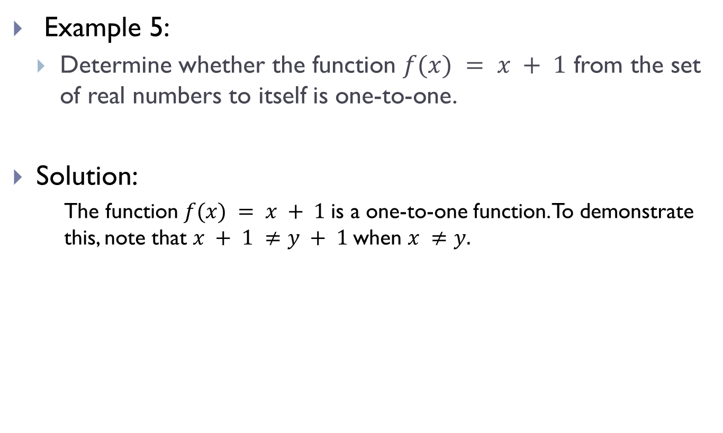
One-to-One Function/Injunctions (Contd.)
Example 5:
Determine whether the function $f(x) = x + 1$ from the set of real numbers to itself is one-to-one.
Solution:
The function $f(x) = x + 1$is a one-to-one function. To demonstrate this, note that $x + 1 ≠y + 1$when $x ≠y.$

Slide 12

Onto Functions/Surjections
A function $f$ from $A$ to $B$ is called onto, or a surjection, if and only if for every element $b ∈ B$there is an element $a ∈ A$ with $f(a) = b$. A function $f$is also called surjective if it is onto.

Slide 13
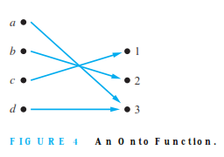
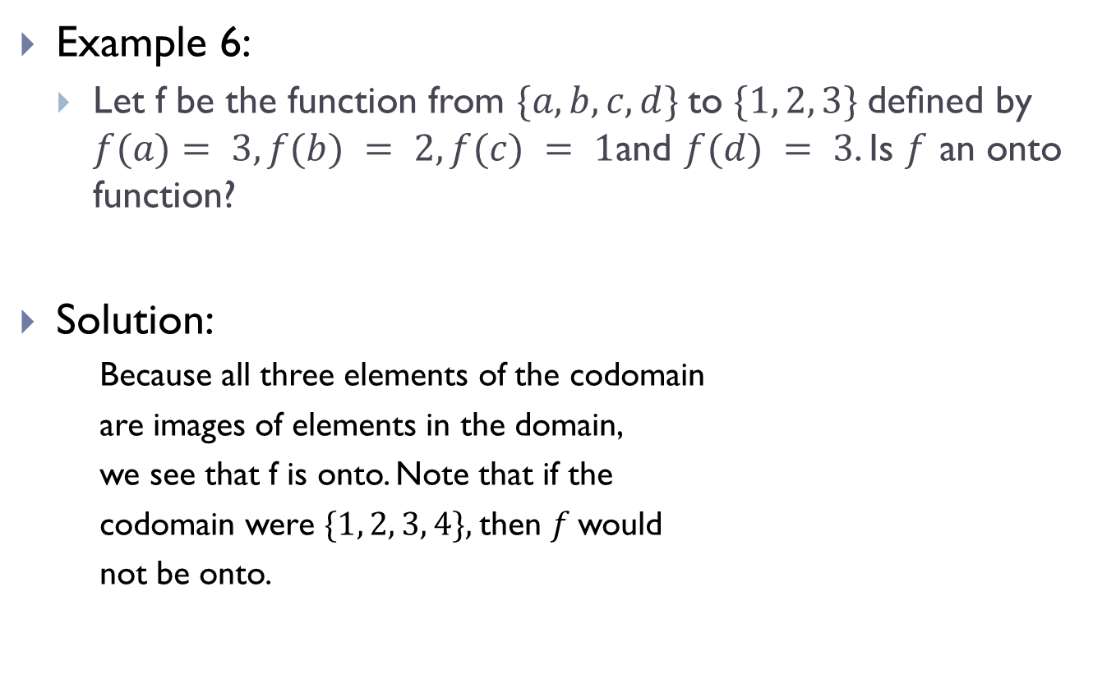
Onto Functions/Surjections (Contd.)
Example 6:
Let f be the function from $\{a, b, c, d\}$to $\{1, 2, 3\}$deﬁned by $f(a)$ $= 3, f(b) = 2, f(c) = 1$and $f(d) = 3$. Is $f$ an onto function?
Solution:
Because all three elements of the codomain
are images of elements in the domain,
we see that f is onto. Note that if the
codomain were $\{1, 2, 3, 4\},$then $f$would
not be onto.

Slide 14
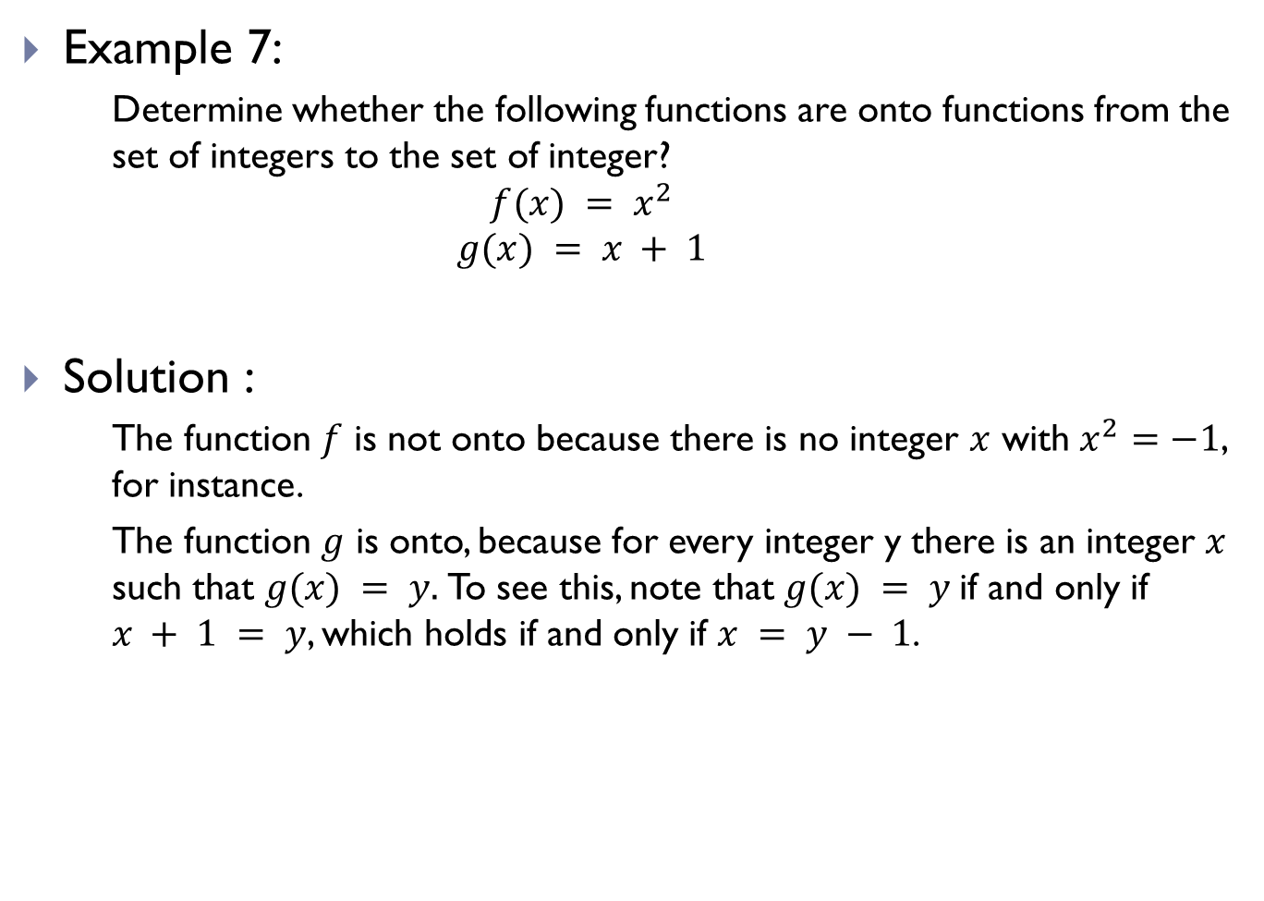
Onto Functions/Surjections (Contd.)
Example 7:
Determine whether the following functions are onto functions from the set of integers to the set of integer?
$$f(x) = x^{2}$$
$$g(x) = x + 1$$
Solution :
The function $f$ is not onto because there is no integer $x$ with $x^{2}=−1$, for instance.
The function $g$ is onto, because for every integer y there is an integer $x$ such that $g(x) = y.$To see this, note that $g(x) = y$if and only if $x + 1 = y$, which holds if and only if $x = y − 1$.

Slide 15
One-to-One Correspondence/Bijections
The function f is a one-to-one correspondence, or a bijection, if it is both one-to-one and onto.
We also say that such a function is bijective

Slide 16
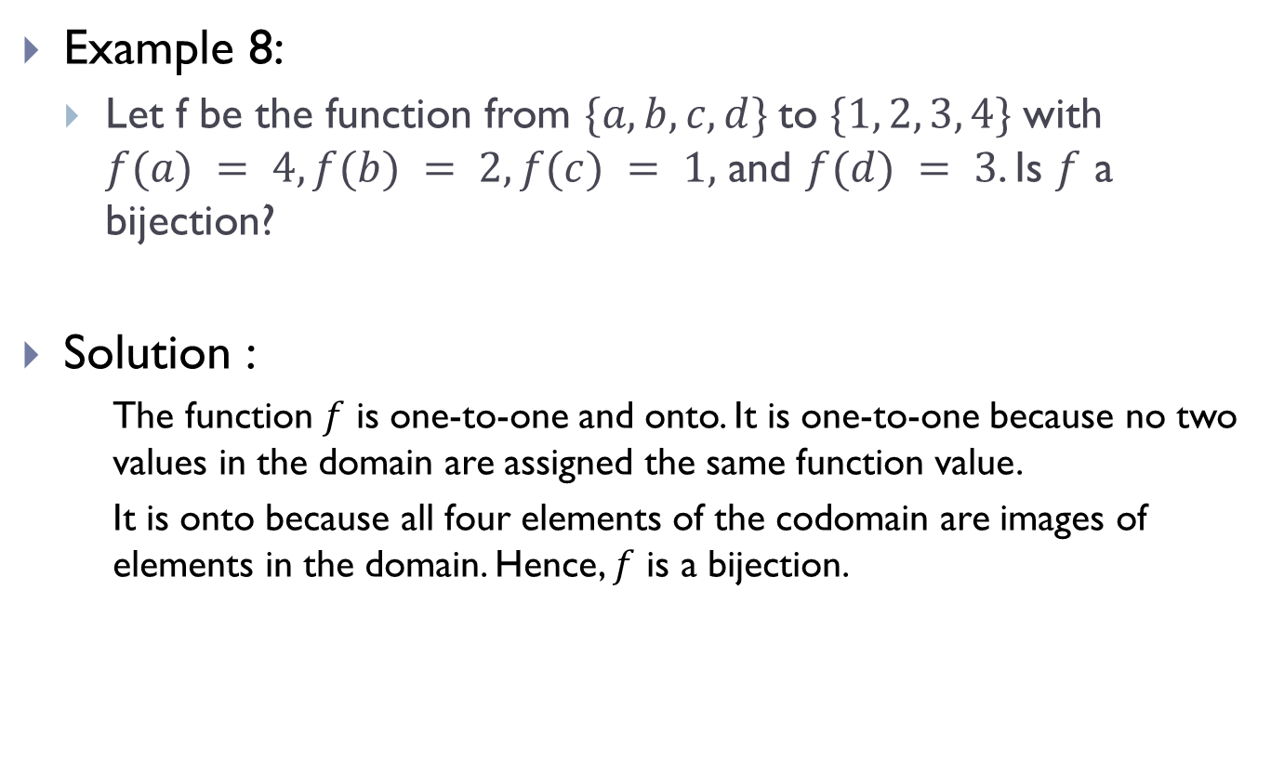
One-to-One Correspondence/Bijections(Contd.)
Example 8:
Let f be the function from $\{a, b, c, d\}$to $\{1, 2, 3, 4\}$with $f(a) = 4, f(b) = 2, f(c) = 1,$ and $f(d) = 3$. Is $f$ a bijection?
Solution :
The function $f$ is one-to-one and onto. It is one-to-one because no two values in the domain are assigned the same function value.
It is onto because all four elements of the codomain are images of elements in the domain. Hence, $f$ is a bijection.

Slide 17
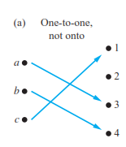
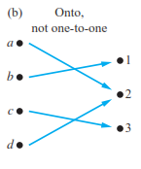
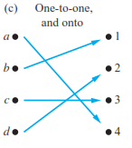
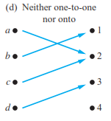
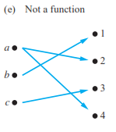
Comparison of One-to-One, Onto, Bijections

Slide 18
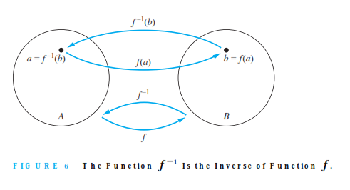
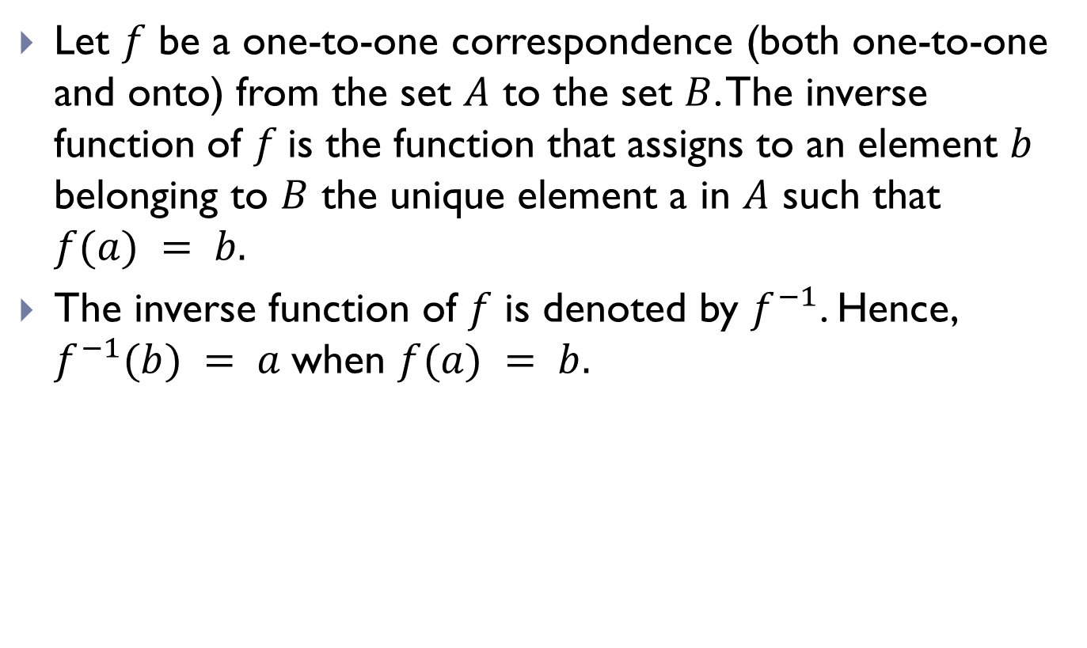
Inverse Functions
Let $f$ be a one-to-one correspondence (both one-to-one and onto) from the set $A$ to the set $B$. The inverse function of $f$is the function that assigns to an element $b$ belonging to $B$ the unique element a in $A$ such that $f(a) = b.$
The inverse function of $f$ is denoted by $f^{−1}$. Hence, $f^{−1}(b) = a$when $f(a) = b.$

Slide 19
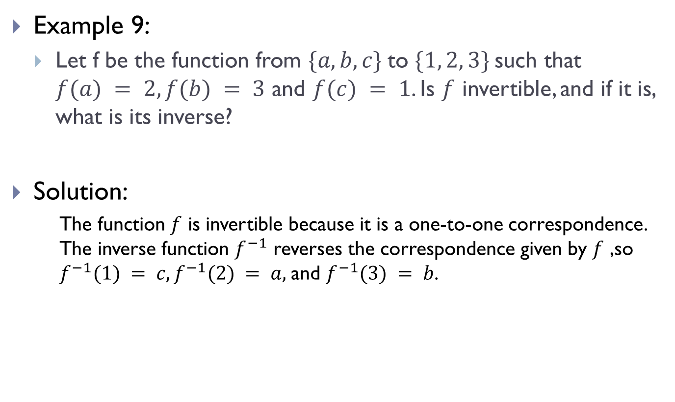
Inverse Functions(Contd.)
Example 9:
Let f be the function from $\{a, b, c\}$to $\{1, 2, 3\}$such that $f(a) = 2, f(b) = 3$ and $f(c) = 1$. Is $f$ invertible, and if it is, what is its inverse?
Solution:
The function $f$ is invertible because it is a one-to-one correspondence. The inverse function $f^{−1}$ reverses the correspondence given by $f$ ,so $f^{−1}(1) = c, f^{−1}(2) = a,$and $f^{−1}(3) = b$.

Slide 20
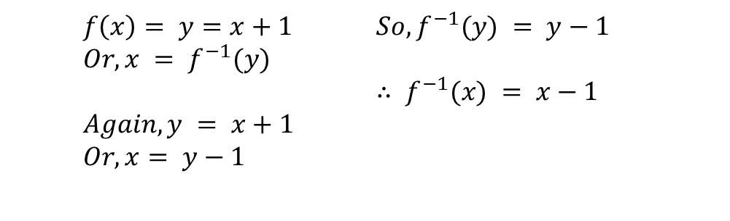
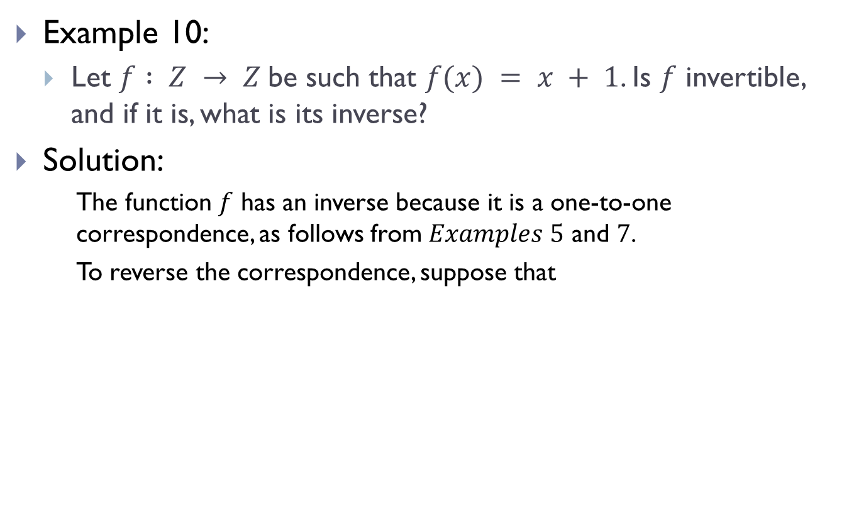
Inverse Functions(Contd.)
Example 10:
Let $f : Z → Z$be such that $f(x) = x + 1$. Is $f$ invertible, and if it is, what is its inverse?
Solution:
The function $f$ has an inverse because it is a one-to-one correspondence, as follows from $Examples 5$ and $7$.
To reverse the correspondence, suppose that
$f\left(x\right)= y=x+1$ $Or, x = f^{−1}(y)$ $Again, y = x+1$ $Or, x= y−1$ | $So, f^{−1}(y) = y−1$ $∴ f^{−1}(x) = x−1$

Slide 21
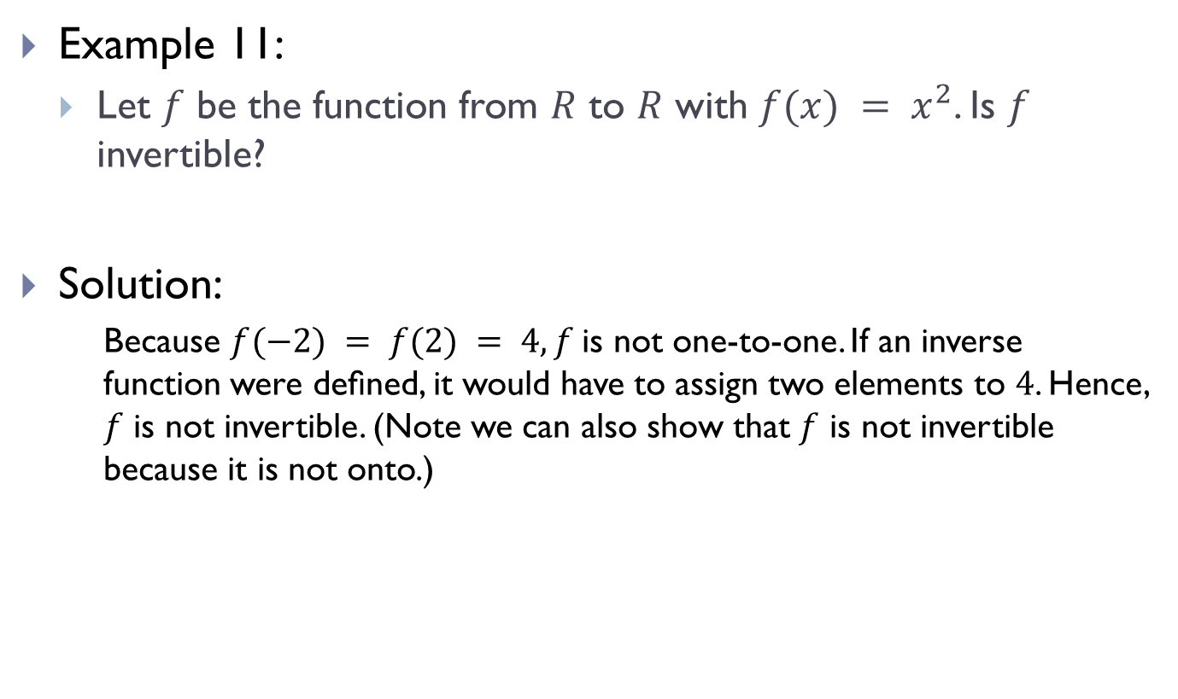
Inverse Functions(Contd.)
Example 11:
Let $f$ be the function from $R$ to $R$ with $f(x) = x^{2}$. Is $f$ invertible?
Solution:
Because $f(−2) = f(2) = 4, f$is not one-to-one. If an inverse function were deﬁned, it would have to assign two elements to $4$. Hence, $f$ is not invertible. (Note we can also show that $f$ is not invertible because it is not onto.)

Slide 22
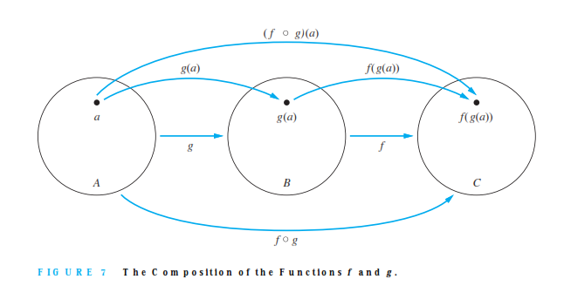

Composition of Functions
Let $g$ be a function from the set $A$ to the set $B$ and let $f$ be a function from the set $B$to the set $C$. The composition of the functions $f$and $g$, denoted for all $a ∈ A$by $fog$, is deﬁned by $(fog)(a) = f (g(a)).$

Slide 23
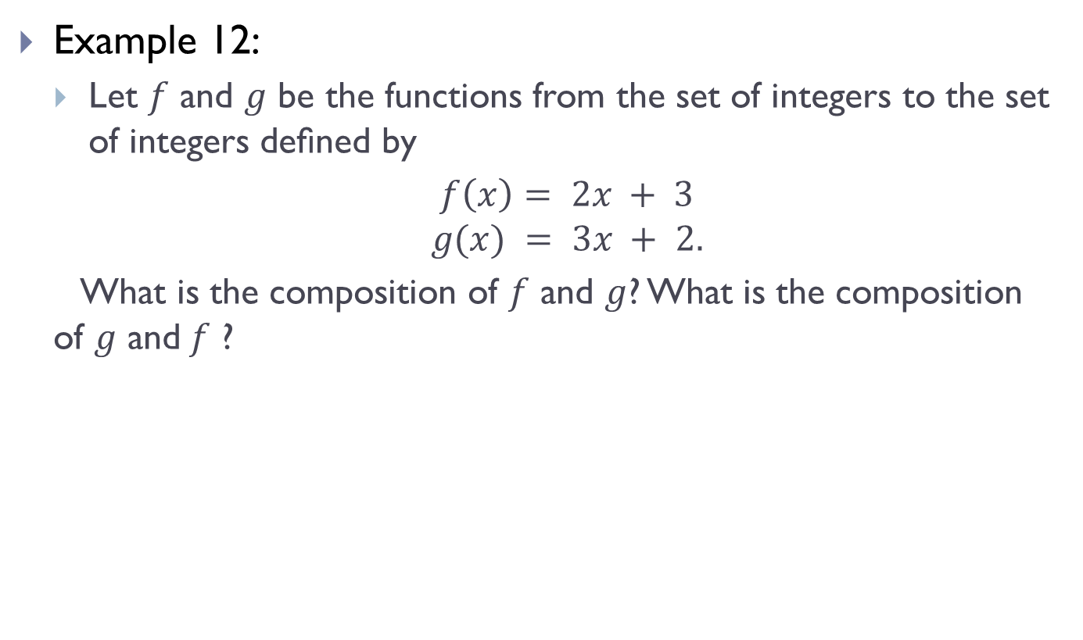
Composition of Functions(Contd.)
Example 12:
Let $f$ and $g$ be the functions from the set of integers to the set of integers deﬁned by
$f\left(x\right)= 2x + 3$
$$g(x) = 3x + 2.$$
What is the composition of $f$ and $g$? What is the composition of $g$ and$f$ ?

Slide 24

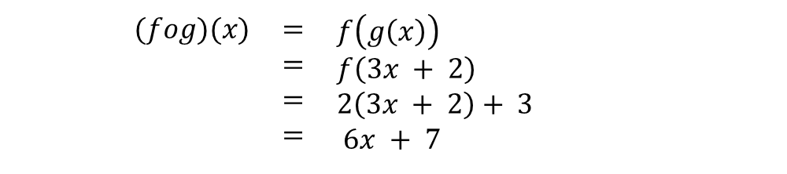
Composition of Functions(Contd.)
Solution :
Both the compositions fog and gof are deﬁned. Moreover,
and
$(fog)(x)$ | $$=$$ $$=$$ $$=$$ $$=$$ | $f\left(g\left(x\right)\right)$ $f\left(3x + 2\right)$ $2\left(3x + 2\right)+ 3$ $6x + 7$
$(gof)(x)$ | $$=$$ $$=$$ $$=$$ $$=$$ | $g\left(f\left(x\right)\right)$ $g\left(2x + 3\right)$ $3\left(2x + 3\right)+ 2$ $6x +11$

Slide 25
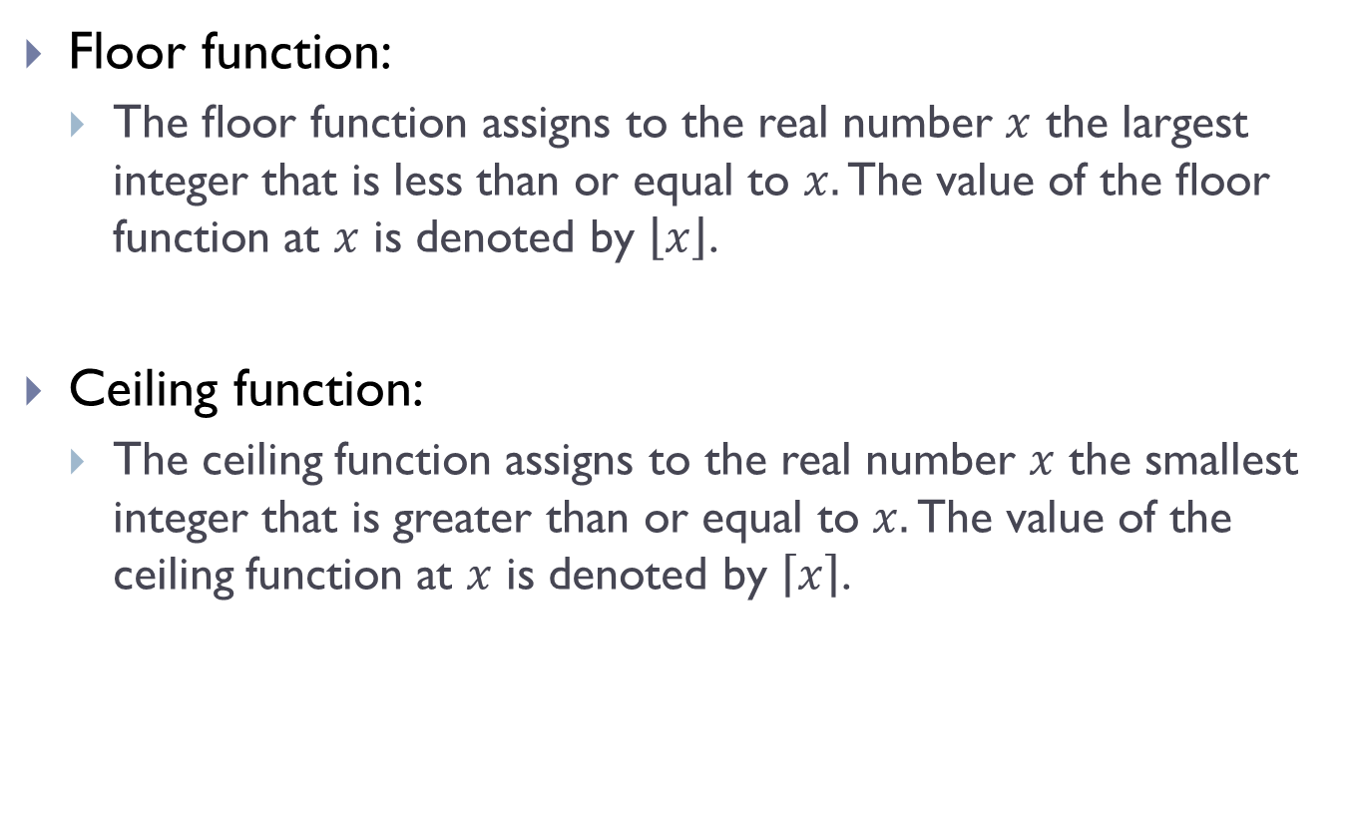
Floor & Ceiling Functions
Floor function:
The ﬂoor function assigns to the real number $x$ the largest integer that is less than or equal to $x.$ The value of the ﬂoor function at $x$ is denoted by $\left\lfloor x\right\rfloor$.
Ceiling function:
The ceiling function assigns to the real number $x$ the smallest integer that is greater than or equal to $x.$ The value of the ceiling function at $x$ is denoted by $\left\lceil x\right\rceil$.

Slide 26
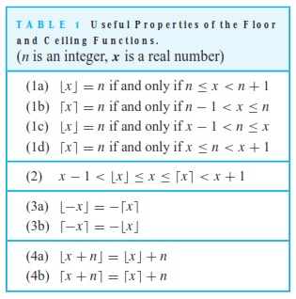
Floor & Ceiling Functions(Contd.)

Slide 27
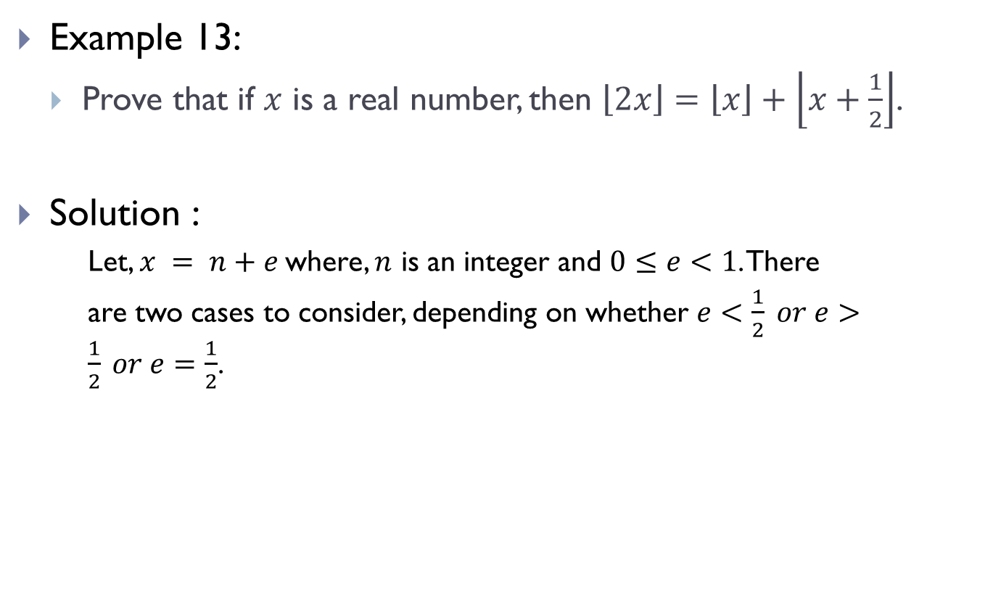
Floor & Ceiling Functions(Contd.)
Example 13:
Prove that if $x$ is a real number, then $\left\lfloor 2x\right\rfloor =\left\lfloor x\right\rfloor +\left\lfloor x+\frac{1}{2}\right\rfloor$.
Solution :
Let, $x = n+e$where, $n$ is an integer and $0≤e<1$. There
are two cases to consider, depending on whether $e<\frac{1}{2} or e>\frac{1}{2} or e=\frac{1}{2}$.

Slide 28
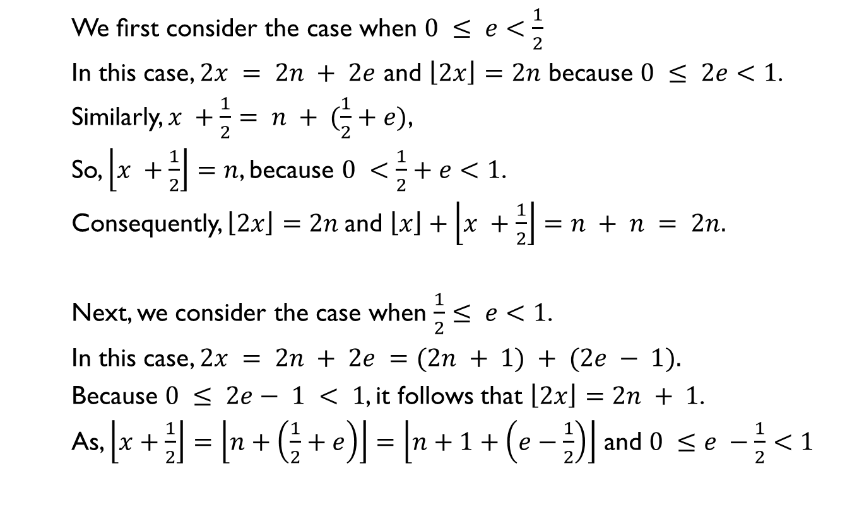
Floor & Ceiling Functions(Contd.)
We ﬁrst consider the case when $0 ≤ e<\frac{1}{2}$
In this case, $2x = 2n + 2e$ and $\left\lfloor 2x\right\rfloor =2n$ because $0 ≤ 2e<1$.
Similarly, $x +\frac{1}{2}= n + (\frac{1}{2}+e)$,
So, $\left\lfloor x +\frac{1}{2}\right\rfloor =n$, because $0 <\frac{1}{2}+e<1$.
Consequently, $\left\lfloor 2x\right\rfloor =2n$and $\left\lfloor x\right\rfloor +\left\lfloor x +\frac{1}{2}\right\rfloor =n + n = 2n.$
Next, we consider the case when $\frac{1}{2}≤ e<1$.
In this case, $2x = 2n + 2e =(2n + 1) + (2e − 1).$
Because $0 ≤ 2e− 1 < 1$, it follows that $\left\lfloor 2x\right\rfloor =2n + 1$.
As, $\left\lfloor x+\frac{1}{2}\right\rfloor =\left\lfloor n+\left(\frac{1}{2}+e\right)\right\rfloor =\left\lfloor n+1+\left(e−\frac{1}{2}\right)\right\rfloor$ and $0 ≤e −\frac{1}{2}<1$

Slide 29

Floor & Ceiling Functions(Contd.)
It follows that, $\left\lfloor x+\frac{1}{2}\right\rfloor =n+1$
Consequently,
$\left\lfloor 2x\right\rfloor =2n + 1 and \left\lfloor x\right\rfloor +\left\lfloor x+\frac{1}{2}\right\rfloor =n + \left(n + 1\right)= 2n + 1.$
This concludes the proof.

Slide 30
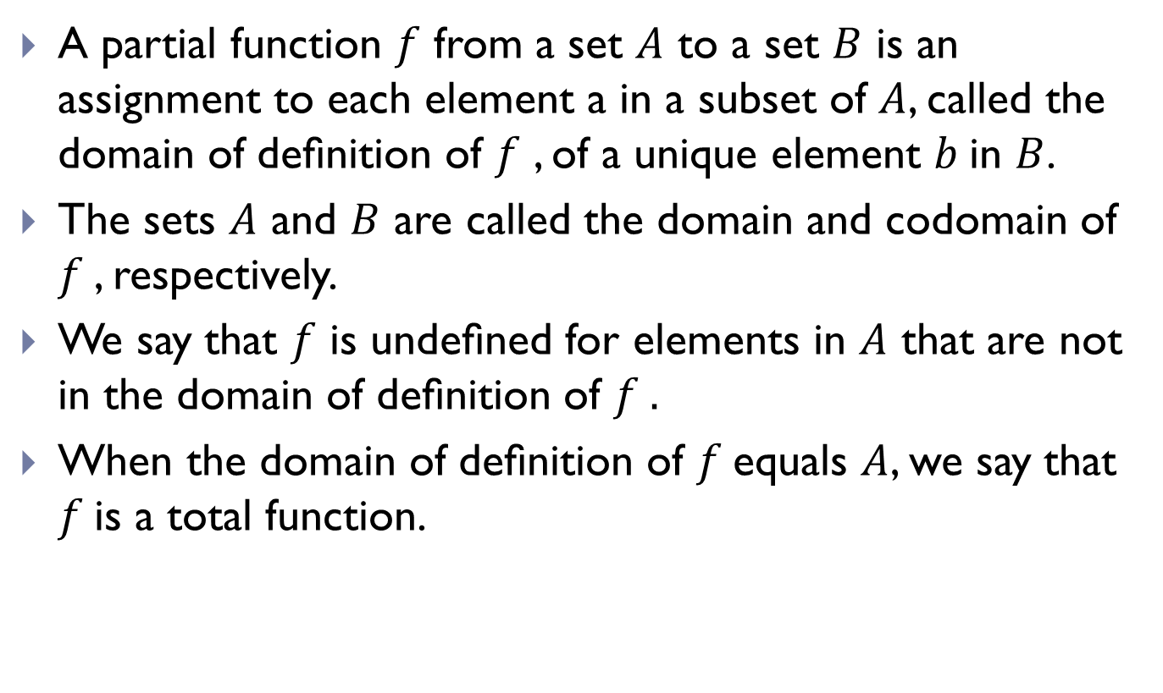
Partial Functions
A partial function $f$ from a set $A$ to a set $B$ is an assignment to each element a in a subset of $A$, called the domain of deﬁnition of $f$ , of a unique element $b$in $B$.
The sets $A$ and $B$ are called the domain and codomain of $f$, respectively.
We say that $f$ is undeﬁned for elements in $A$ that are not in the domain of deﬁnition of $f .$
When the domain of deﬁnition of $f$equals $A$, we say that $f$is a total function.

Slide 31
THE END

